Slide 1
Go Best Cab CA1
DAAA/FT/2B/01
Tan Wen Tao Bryan (2214449)
Ryan Yeo (2214452)
Zachary Leong Yao Jie (2201861)
Ethan Pang Kin Fong (2214241)

Slide 2
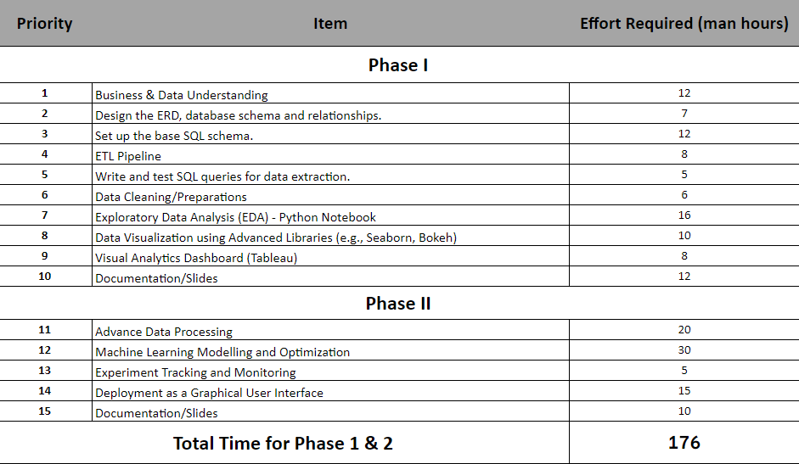
Product Backlog
PHASE 1 of the Project

Slide 3
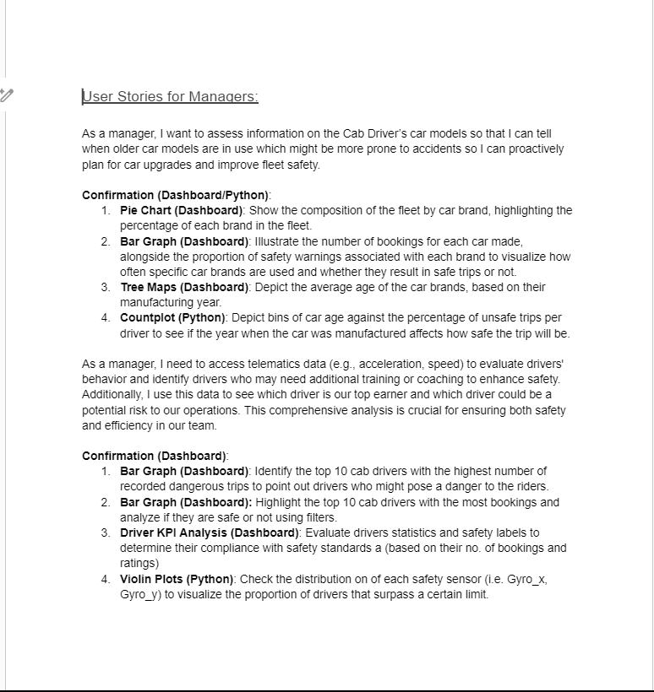
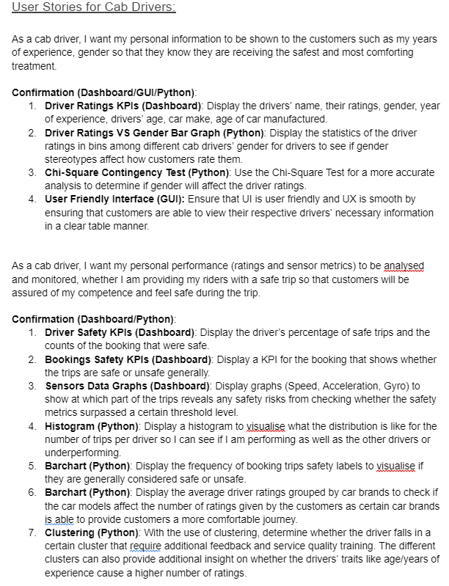
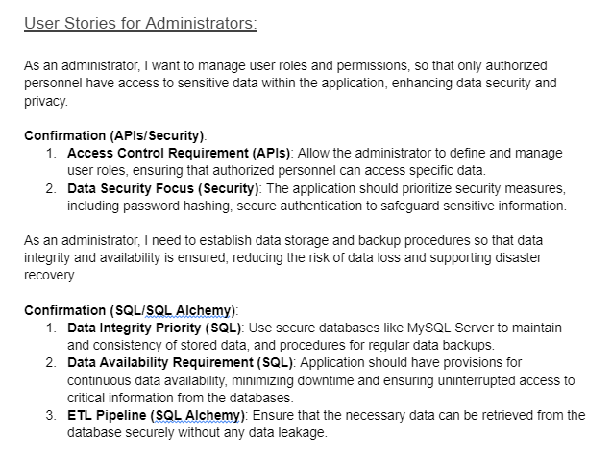
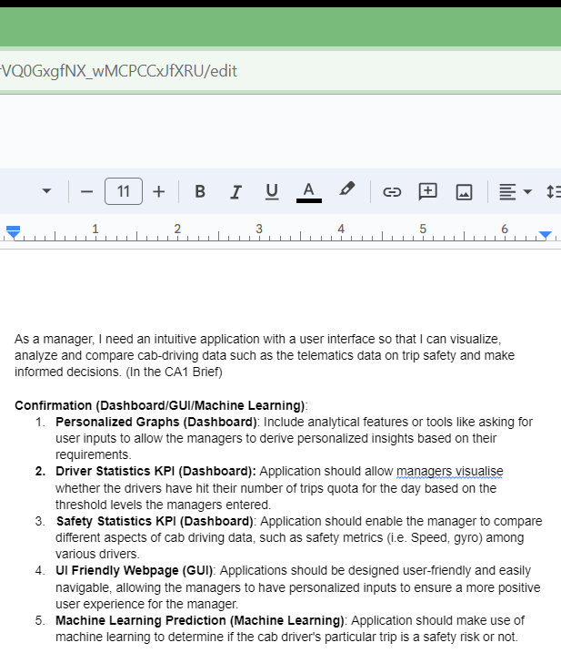
User Stories
Manager
Cab Drivers
Administrators

Slide 4
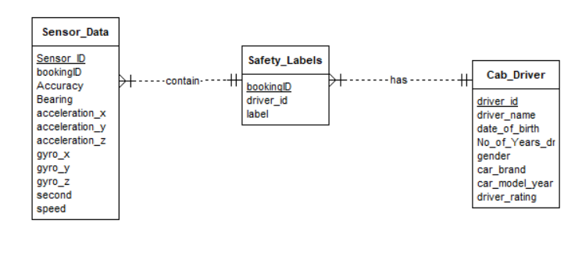
ERD (Database Design)

Slide 5
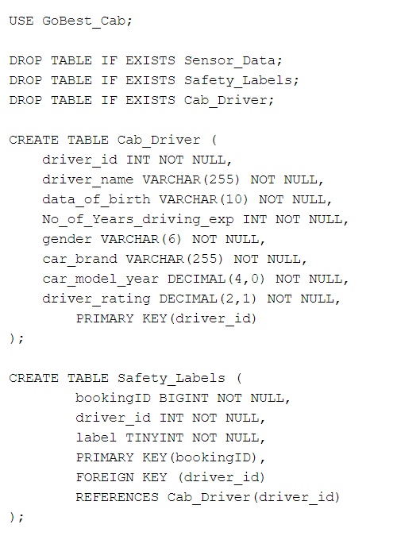
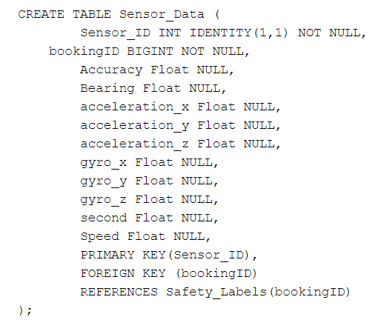
Table Creation

Slide 6
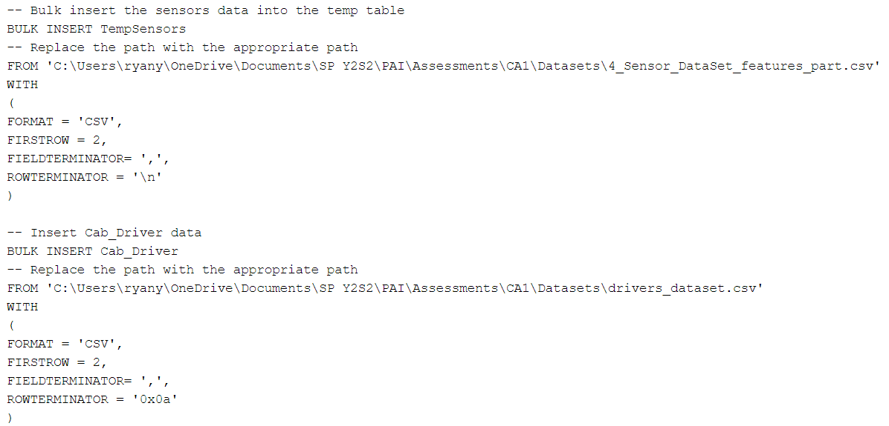
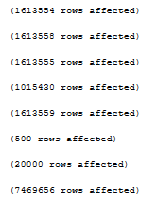
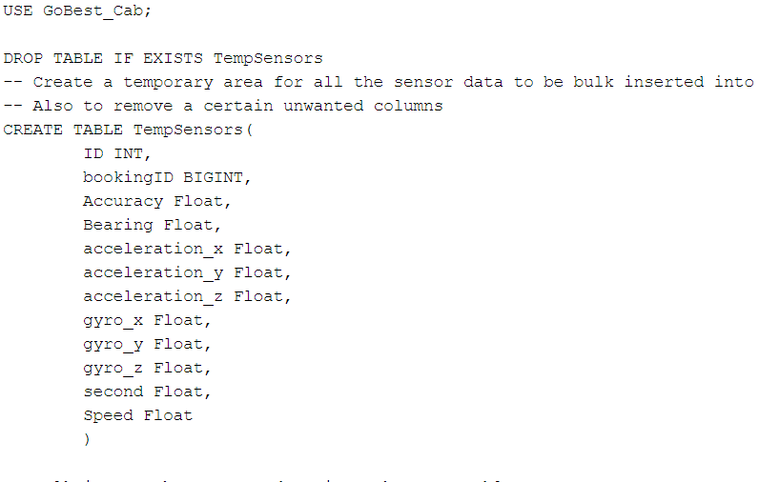
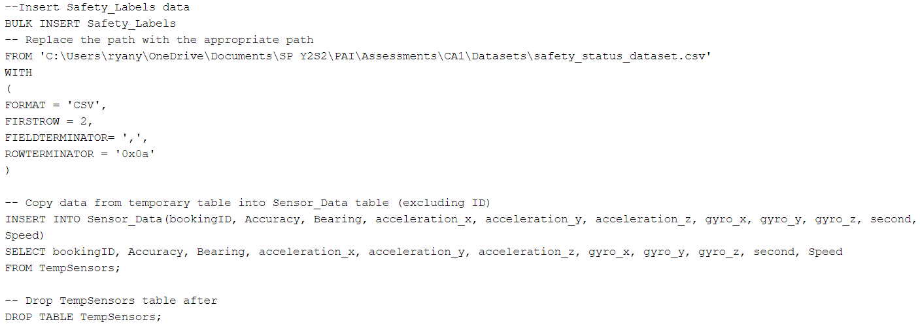
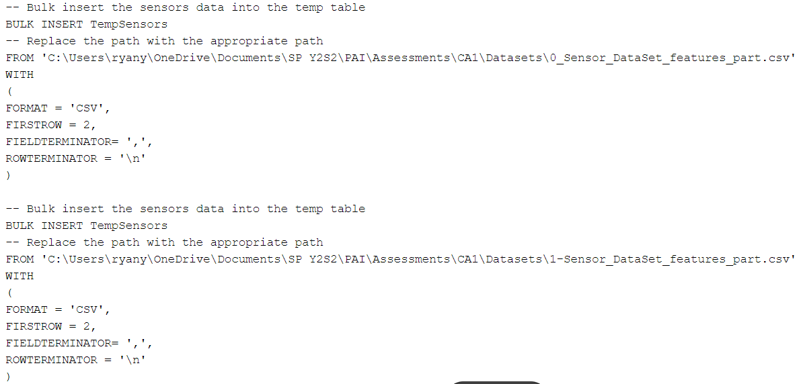
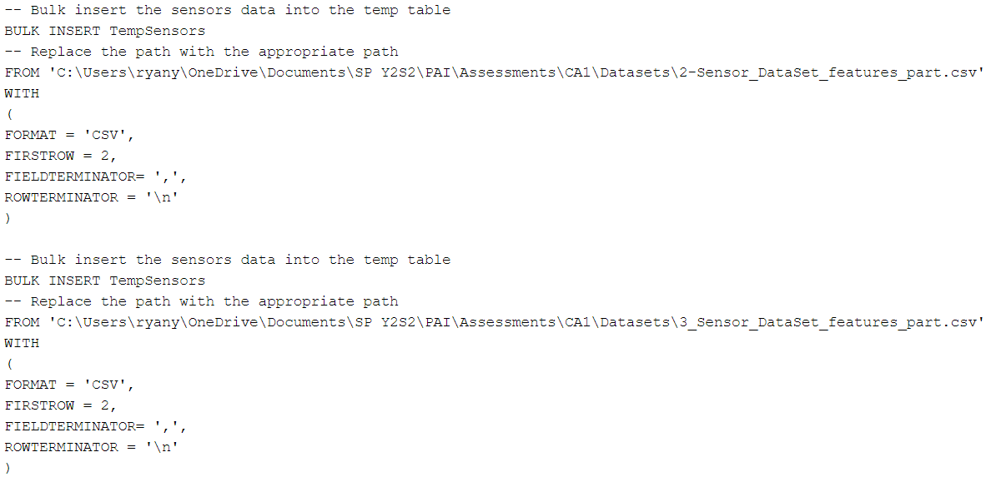
Data Insertion

Slide 7
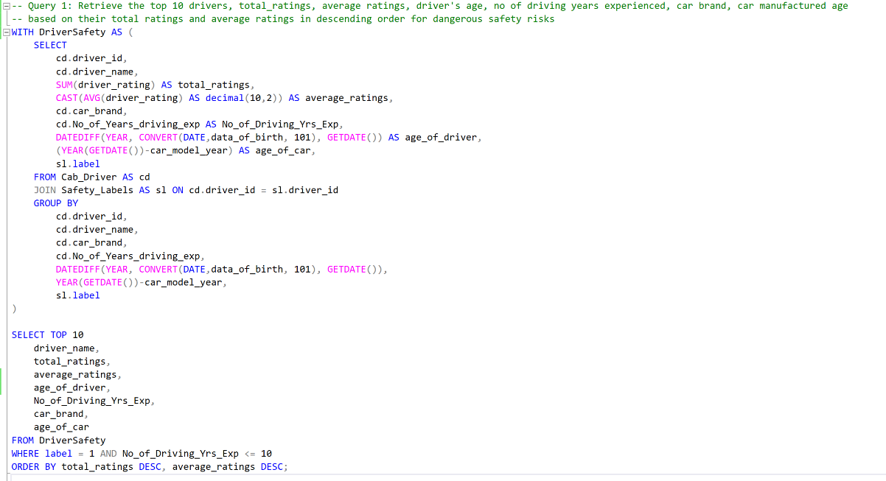

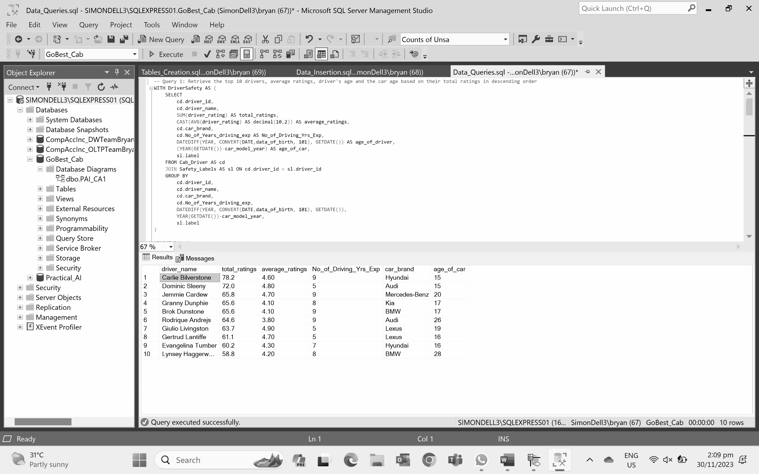
SQL Query 1
Insight:
Carlie Bilverstone is the driver with the highest total ratings. Out of the top 10 drivers, Rodrique Andrejs has the lowest average ratings but a high total rating. This suggests that he had some trips that had higher ratings compared to the other drivers and some of lower ratings, increasing the total ratings.

Slide 8
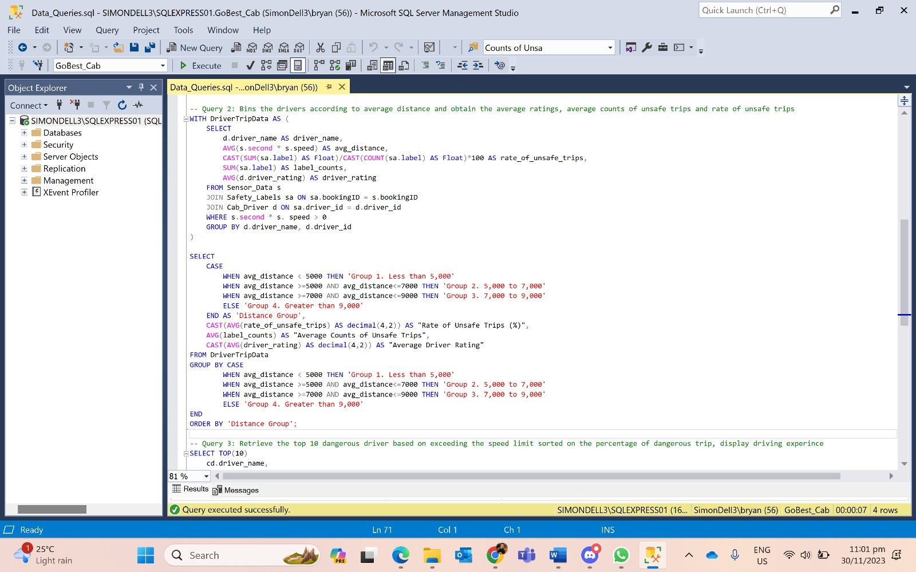
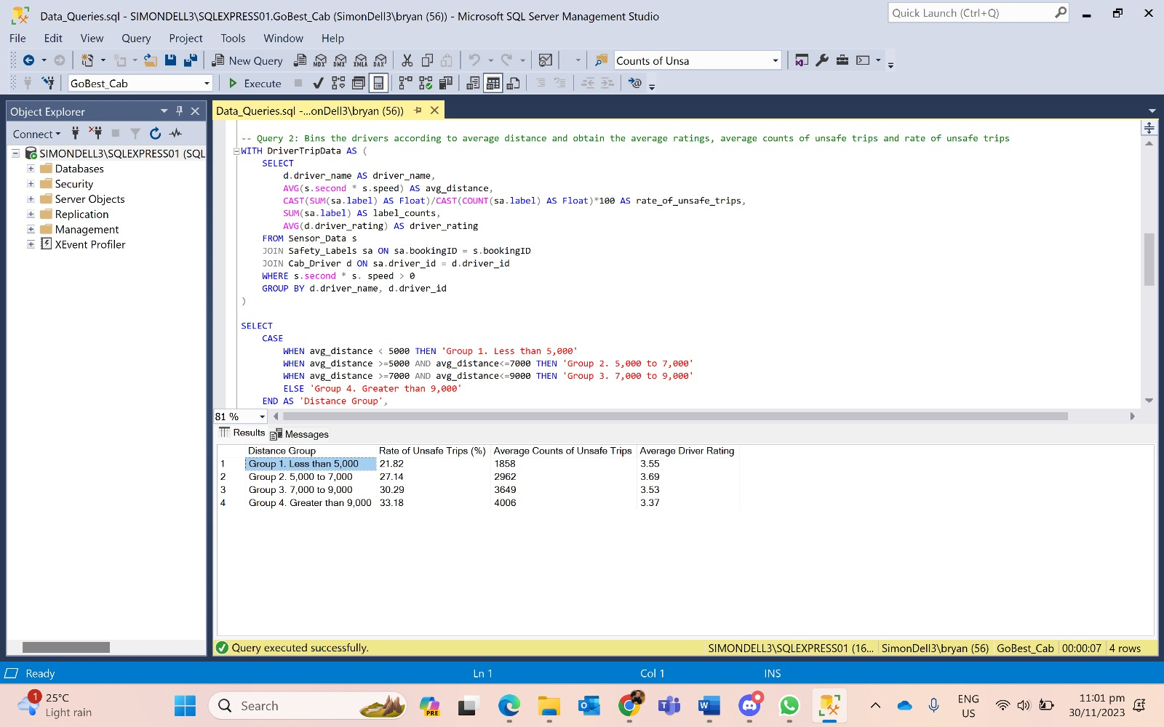
SQL Query 2
Insight:
The table shows that drivers that drive longer trips tend to have a greater number of unsafe trips and a greater rate of unsafe trips. However, their average driver ratings are not as affected by the distance on average.

Slide 9
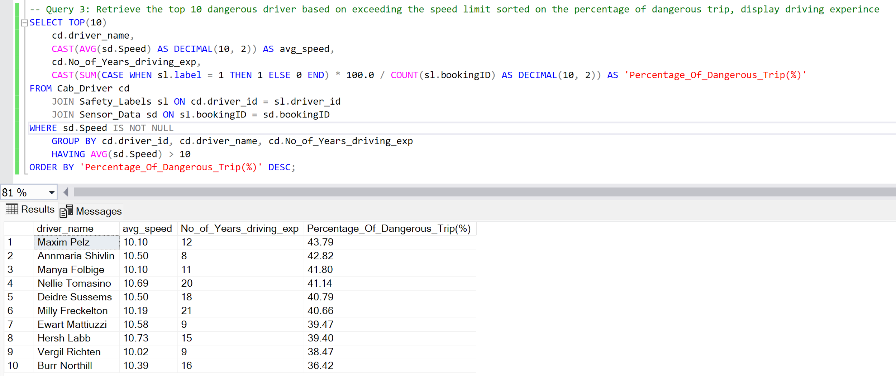
SQL Query 3
Insights:
Drivers who exceed the speed limit of 10m/s pose a danger to their riders based on the percentage of dangerous trips. Number of years driving experience does not affect the percentage of dangerous trips.

Slide 10
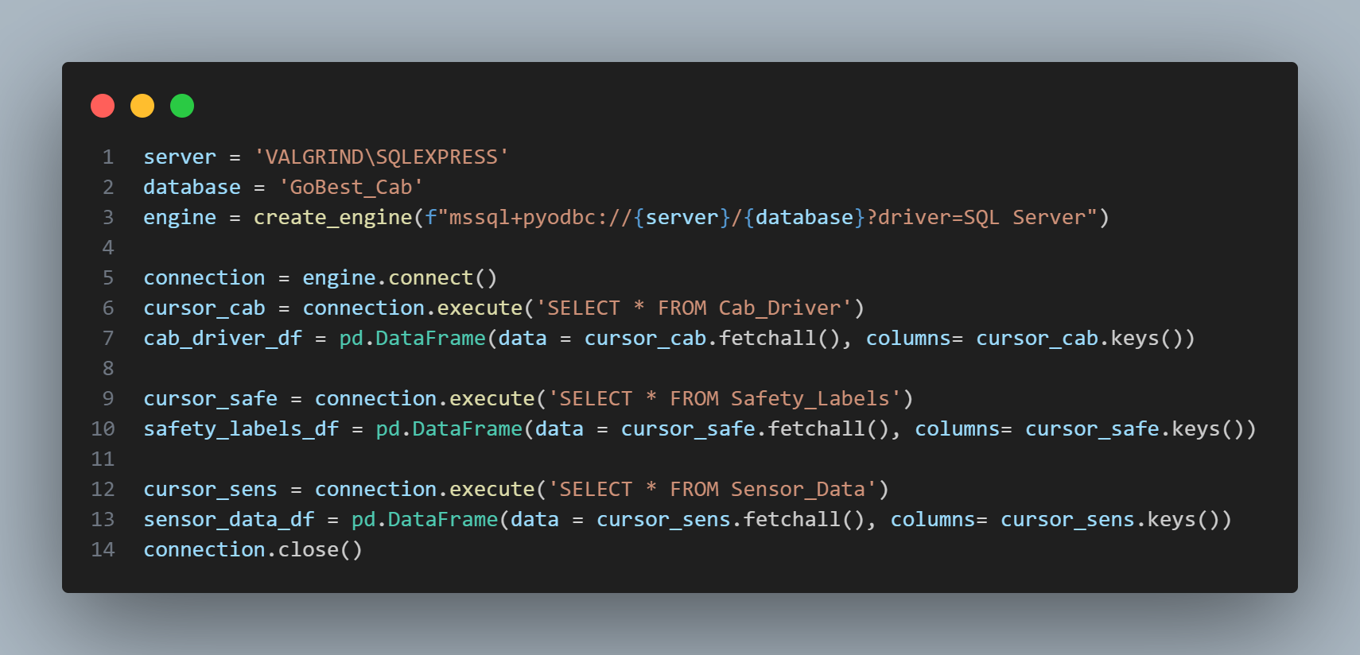
ETL Pipeline

Slide 11
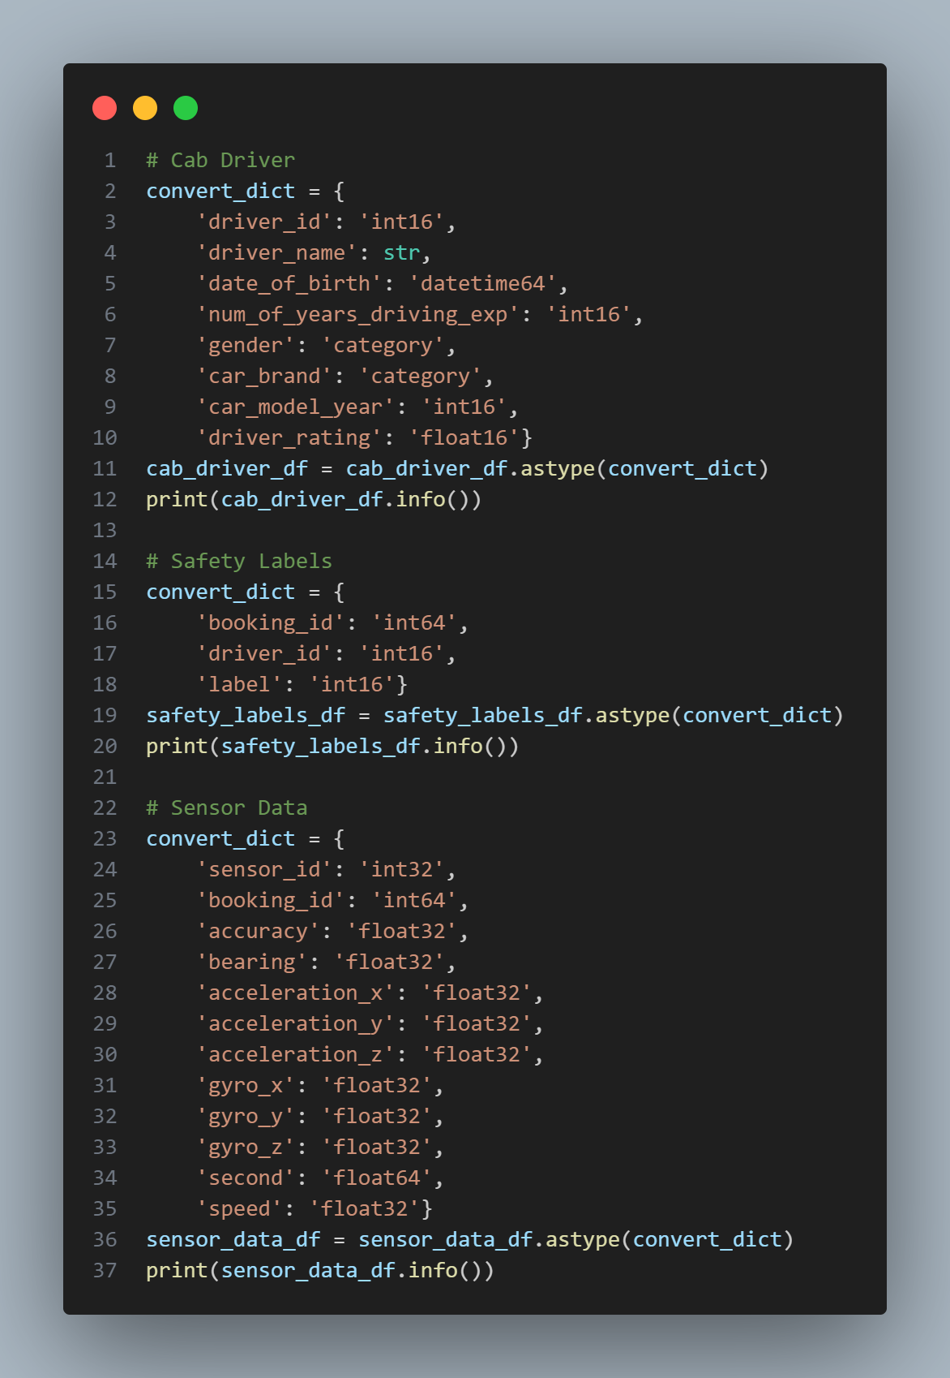
Data Preprocessing (Data Type Conversion)

Slide 12
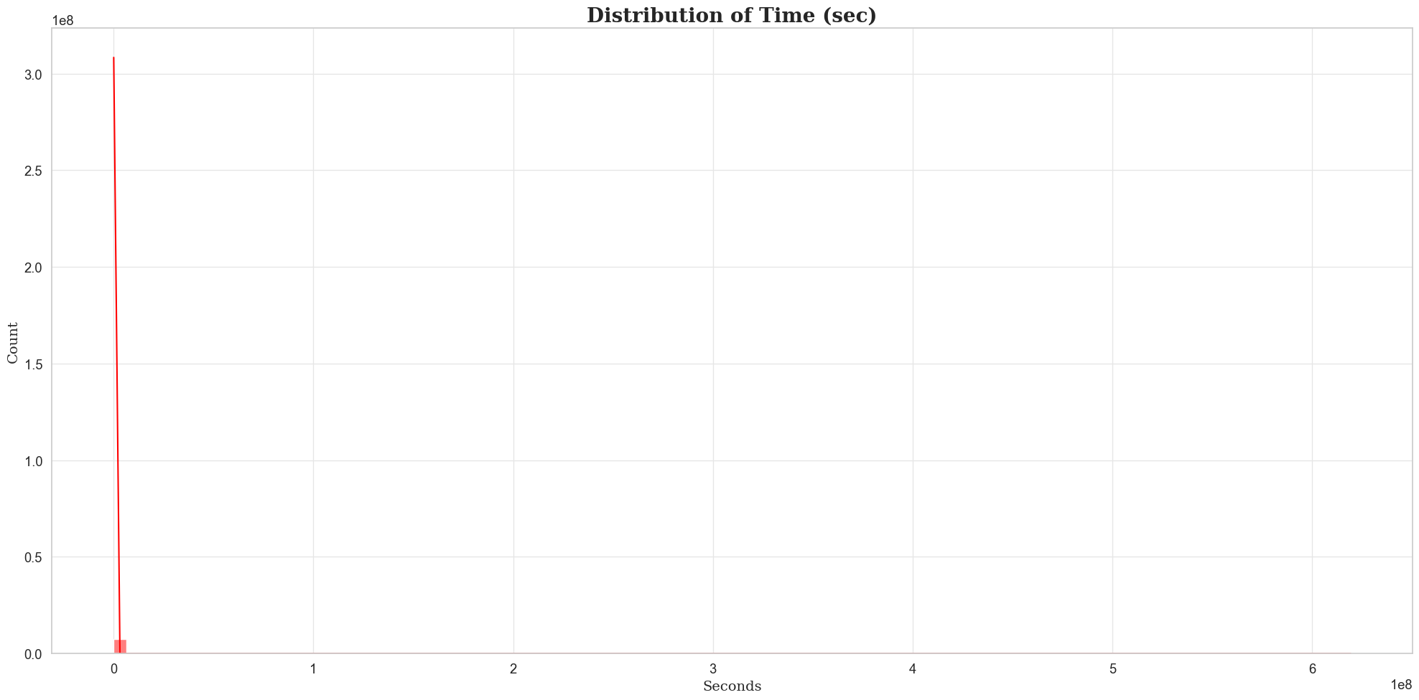
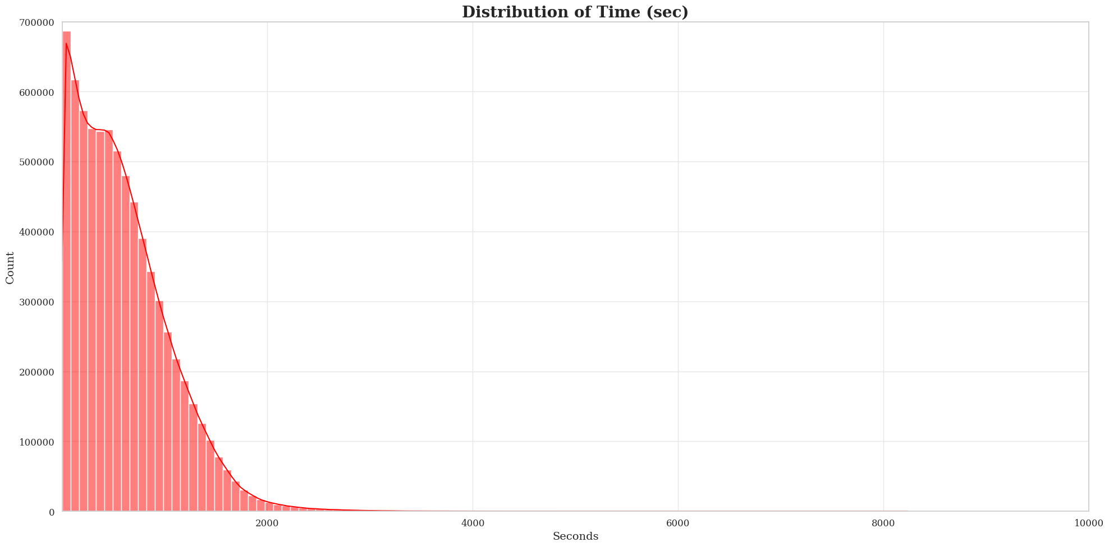
Data Transformation (Removal of Extreme Values)
Before Removal of Outliers
After Removal of Outliers
222,777 from seconds column removed.
120,193 from speed column removed.
Total rows removed: 342,970.

Slide 13
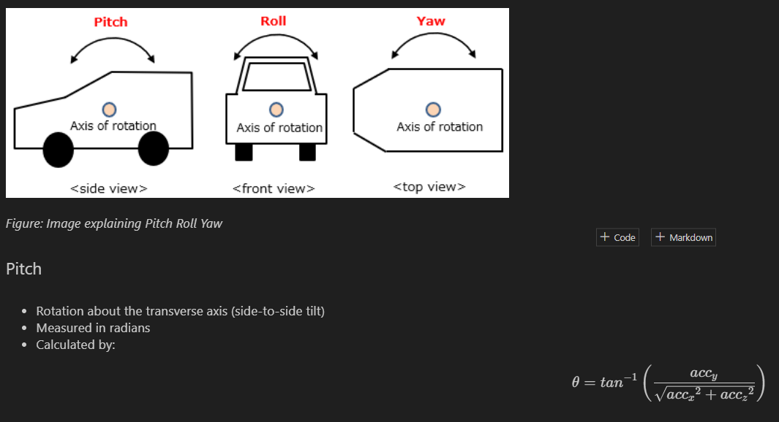
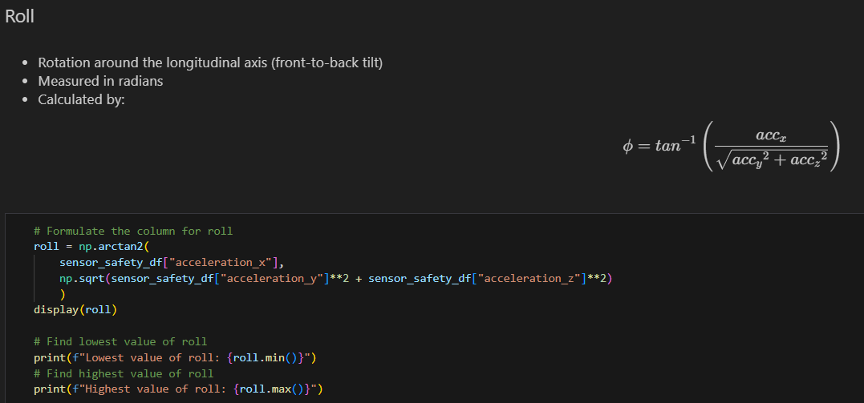
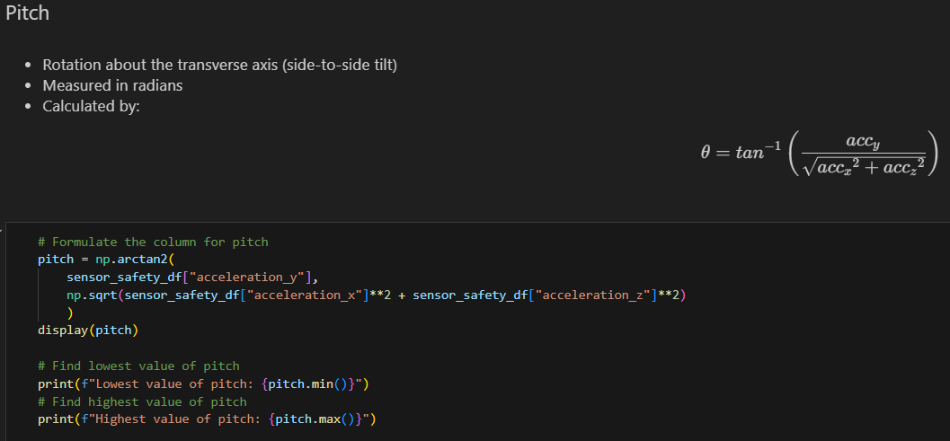
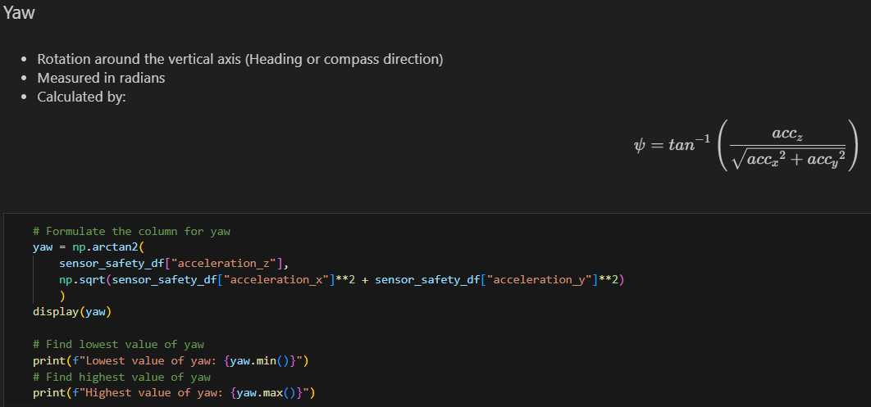
Feature Engineering (Pitch, Roll, Yaw)

Slide 14
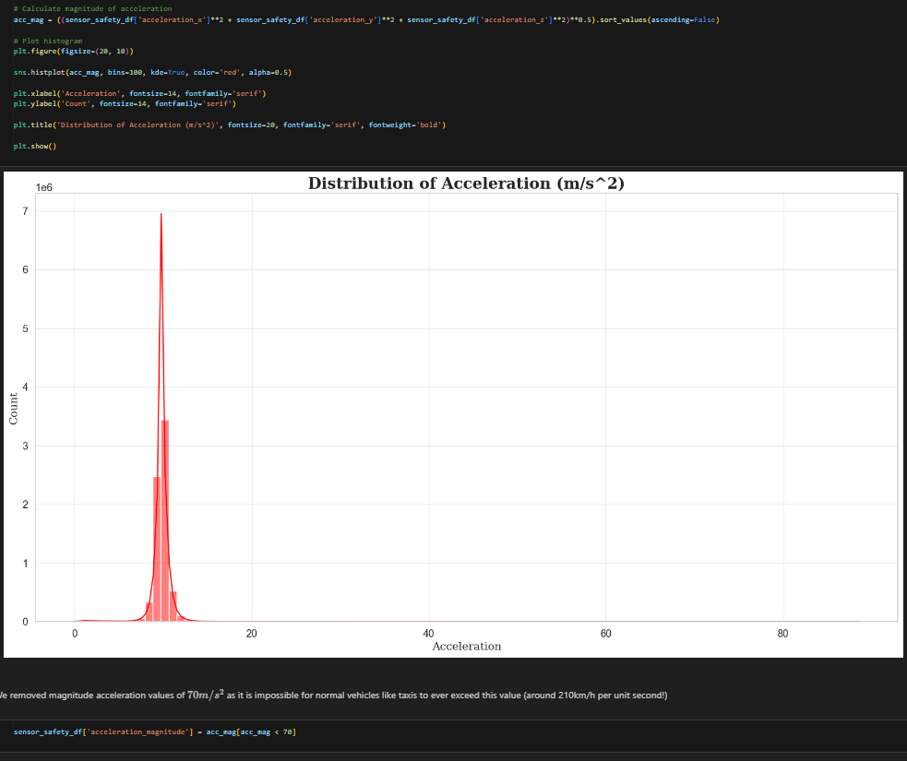
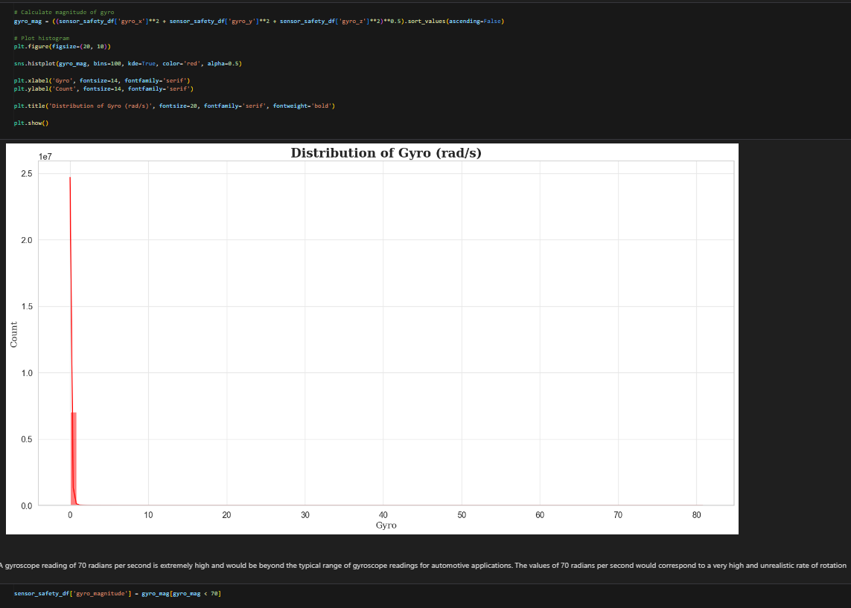
Feature Engineering (Acceleration and Gyro Magnitude)

Slide 15
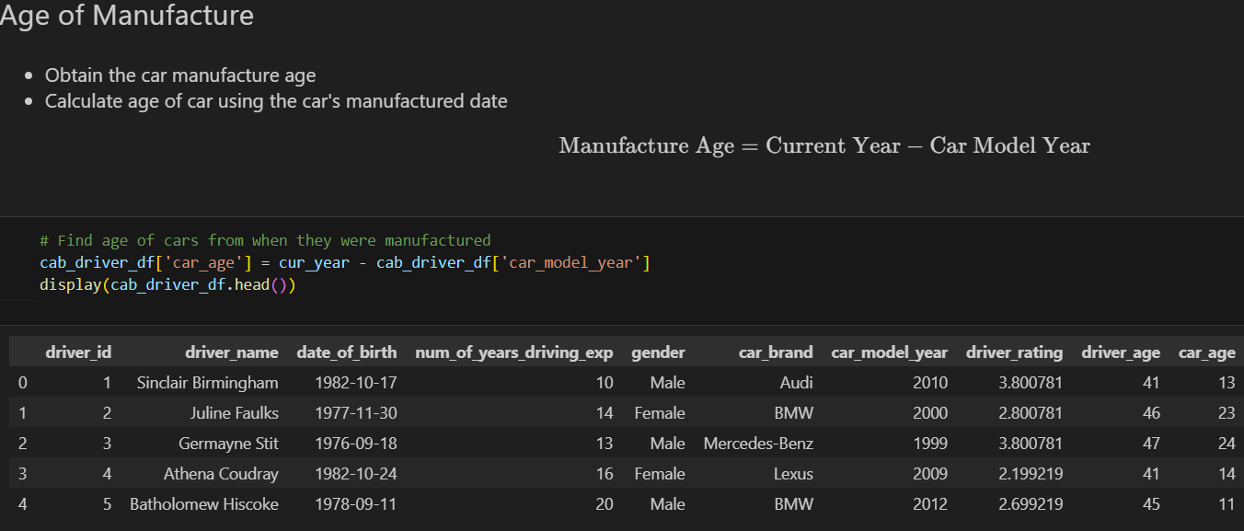
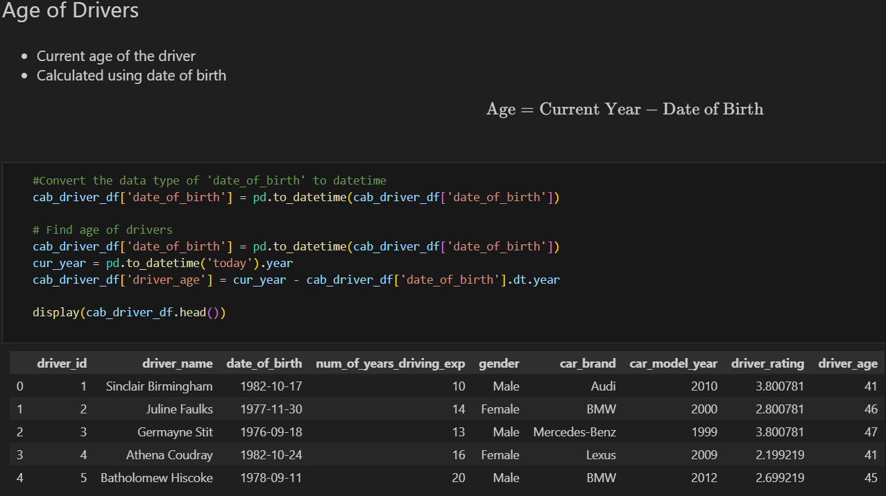
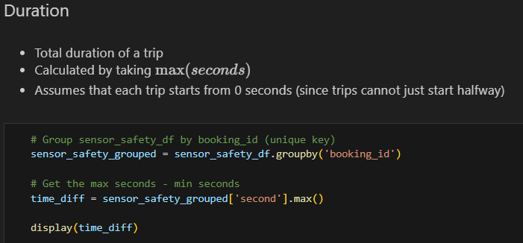
Feature Engineering (Driver Age, Car Manufacture Age, Duration)

Slide 16
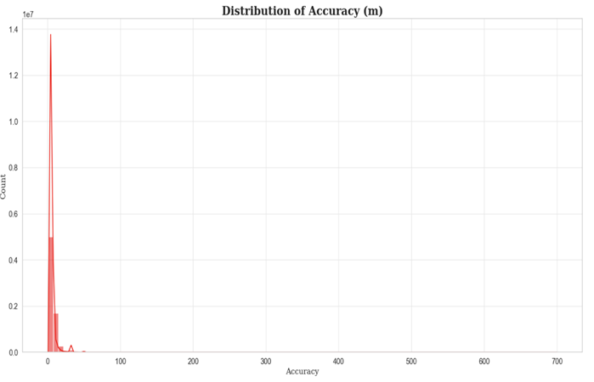
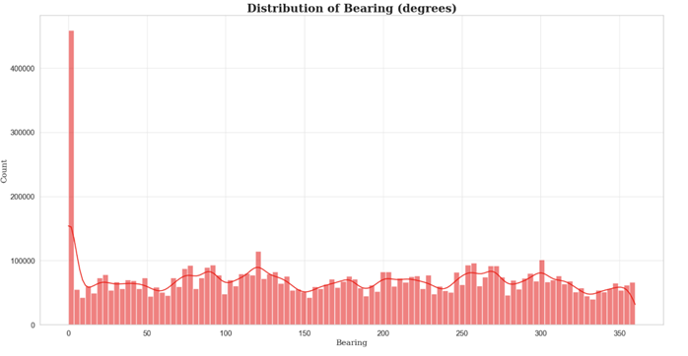
Exploratory Data Analysis (Accuracy & Bearing)
Insight: Extremely negatively skewed which shows that most GPS readings of the cab are quite accurate
Insight: Values of close to 0 are the most common which shows that most cabs were detected going north

Slide 17
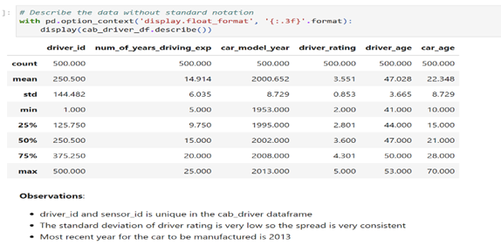
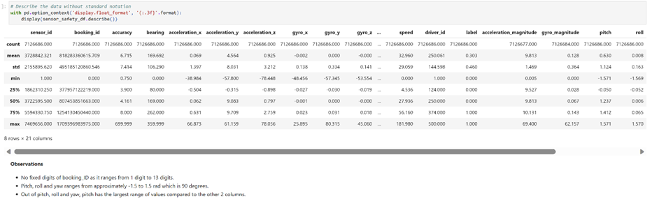
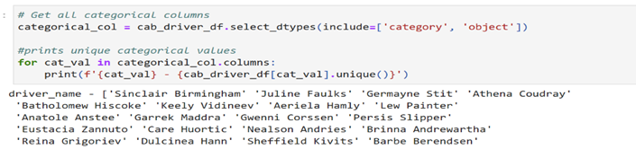
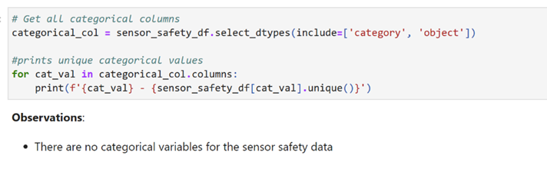
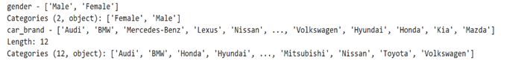
Exploratory Data Analysis (Statistics)
Cab Driver (Statistical Description)
Sensor Data + Safety Labels (Statistical Description)
Cab Driver (Unique Categorical Variables)
Sensor Data + Safety Labels (Unique Categorical Variables)

Slide 18
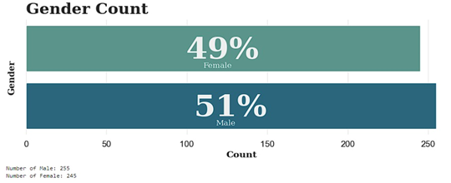
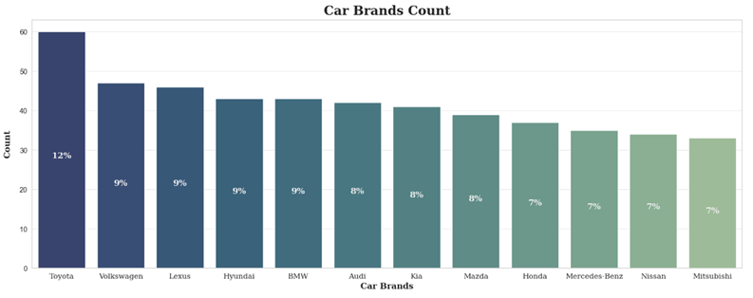
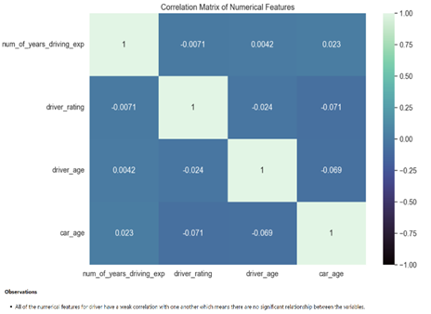
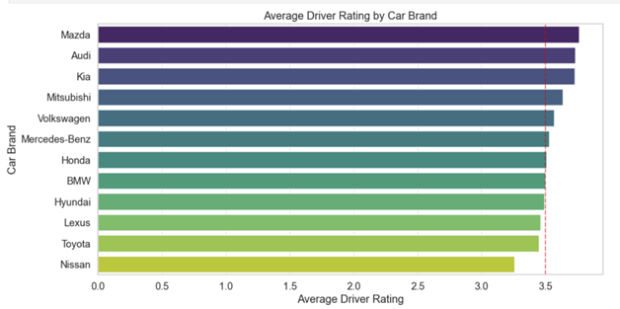
Seaborn/Matplotlib Data Viz (Car Driver)
Insight: Toyota has the most drivers which make up 12% of total cars
Insight: There are slightly more male drivers compared to female drivers
Insight: Cars that have an average driver rating that surpassed the threshold of 3.5, may suggest that the riders have a comforting and comfortable ride.
Insight: Nissan has the least average driver ratings which might be due to the noise produced to the engines compared to more luxurious brands
Insight: All numerical variables have a weak correlation with one another in the cab driver dataset.

Slide 19
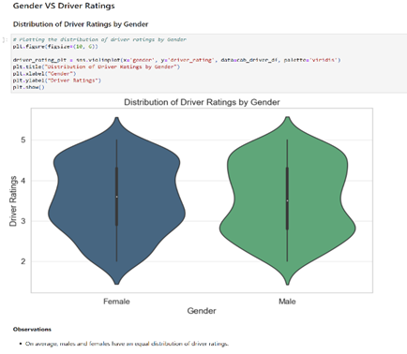
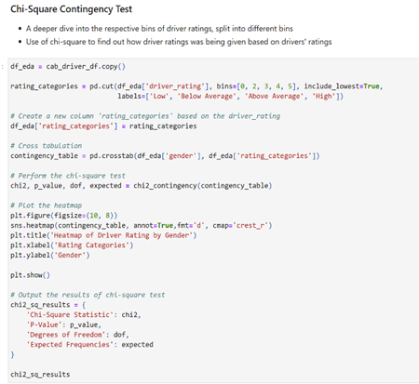
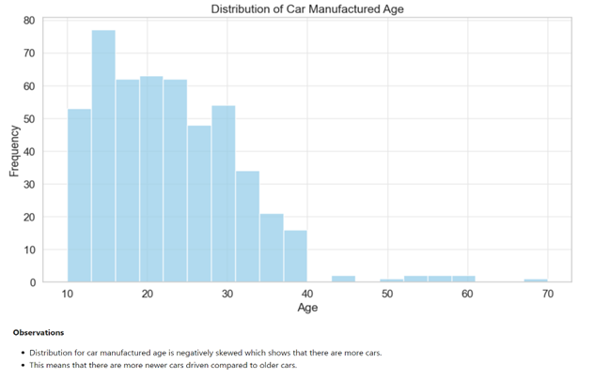
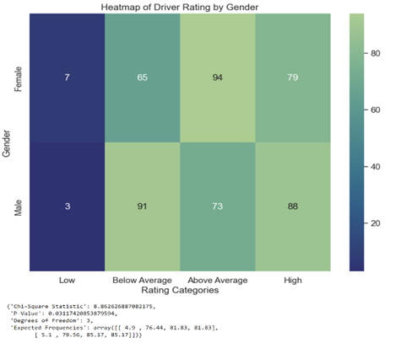
Seaborn/Matplotlib Data Viz (Car Driver)
Insight: Test results indicate that there is a statistically significant association between gender and driver rating categories, as p-value of 0.03 is less than the p-value benchmark of 0.05, suggesting that driver ratings may be influenced by gender.
Insight: There are greater number of female drivers with above average driver ratings (3<=x<4) but greater number of male drivers with below average (2<=x<3) and high driver ratings (4<=x) and has a very small number of drivers with low ratings.

Slide 20
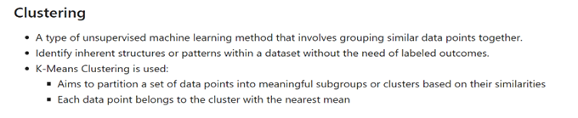
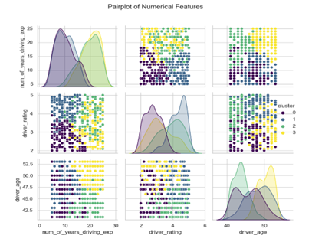
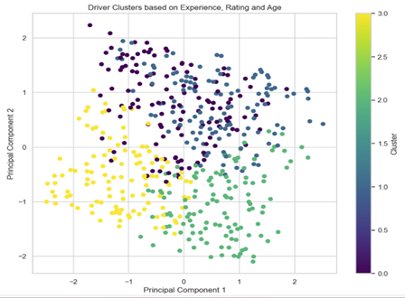


Seaborn/Matplotlib Data Viz (Cab Driver)
Pairplot of Cluster Features
PCA of Clusters
WCSS(Within Cluster Sum of Squares Plot)
Insight: Cluster 2 has more drivers who are near middle-aged (~40 years old) while cluster 3 has more drivers who are older (>50 years old)
Number of clusters chosen is 4 but may not be most optimal as there is no obvious elbow
Insight: Cluster 1 has higher ratings while cluster 0 has lower ratings
Insight: Cluster 2 and 3 have a mix of both high and low ratings
Insight: Cluster 0 and 1 have drivers with fewer number of driving experience years whereas cluster 2 and 3 have drivers with a higher number of driving experience years

Slide 21




Seaborn/Matplotlib Data Viz (Cab Driver)
Cluster Interpretations
Insight:
- High number of driving experience years and perfect driver ratings but average age
- Extremely low number of driving experience years but low driver ratings and old age
- Extremely low number of driving experience years and younger age (around 43) but low driver ratings
Anomaly Detection

Slide 22



Seaborn/Matplotlib Data Viz (Sensor Data)
Distribution of Acceleration
Distribution of Gyro
Distribution of Pitch, Roll and Yaw
Insight: Acceleration_x and Acceleration_z has a mean value of 0m/s^2 and a normal distribution
Insight: Acceleration_y is the gravitational force acting upwards and downwards on the car hence reaching only values of 10m/s^2
Insight: Gyro_x, gyro_y and gyro_z have a mean value of 0 radians per second and a non-normal distribution
Insight: Roll and Yaw have a mean value of 0 radians and a normal distribution
Insight: Pitch which is the tilting angle when going upslope or downslope is mainly around the values of 1.5 and -1.5

Slide 23


Seaborn/Matplotlib Data Viz (Sensor Data)
Insight: Generally more safe trips than unsafe trips
Insight: The number of trips per driver has a normal distribution centered around 40 trips

Slide 24


Seaborn/Matplotlib Data Viz (Sensor Data + Safety Labels)
Insight: In general, it seems that for most factors, the percentage of unsafe trips are equally distributed for each bin.
For car age, we can see that even though the average percentage of unsafe trips per driver is around the same at 25%, the confidence interval for older cars such as 30-40 and >40 is much larger compared to the younger cars. This indicates that there is a higher variability in the safety of trips for older cars.
From the scatter plot, it seems that there is no correlation between the number of trips per driver and percentage of unsafe trips per driver.
Insight: No correlation relationship except for the features we have engineered ourselves (i.e. pitch, roll, yaw, distance)

Slide 25

Bokeh Plots (Driving Ratings VS Binned Ratings for Each Genders)
Insight: The values are more extreme for females than males having more 2-3 star ratings and more 4-5 star ratings.

Slide 26



Bokeh Plots (Ratings VS Speed Violators)
Insight: It seems that the number of instances in which drivers were travelling at the normal speed (0-50km/h) and at the expressway speeds (50-90km/h) were not affected by the rating of the drivers.
We can't really see the number of instances which crossed the violation speed (>90 km/h) since they are a lot fewer compared to the count of instances which were travelling at the normal speed and those travelling at expressway speeds.
Insight: It seems that the number of instances where the driver's were driving at dangerous speeds were only around 450 km/h.
The number of instances which were travelling at the violator speed also seem to not be affected by the rating of the drivers.

Slide 27



Bokeh Plots (Distance VS Average Driver Ratings/Trip Safety)
Insight: It seems that drivers who drives longer trips on average have a slightly greater percentage of unsafe trips, hence distance affects the safety of the trip.
Insight: However drivers who drive for longer trips do not have their average ratings affected that badly, which means distance does not affect the average driver ratings.

Slide 28

Tableau Dashboard (Manager – Safety Label Analysis)
Insight (Pie Chart): Toyota has a larger distribution compared to other makes. The fleet sizes for each make range from 33 to 60.
Insight (Heat Map): Honda has the highest average age, indicating to the manager the potential need to upgrade Honda cabs for fleet safety.
Insight (Bar Chart): Similarly to the Pie Chart, there's a large distribution of Toyota cabs. Across different makes, the percentage of bookings with safety warnings is consistent, ranging from 24.02% to 26.23%.

Slide 29

Tableau Dashboard (Manager - Safety Labels Analysis)
Insight (KPI): This KPI shows the drivers who passed based on manager’s KPI input filters showing if they hit quota; stay under speed limit; stay under gyro limit; stay under total safety warnings; above targeted user rating.
Insight (Dangerous Driver Bar Chart): Shows the top 10 drivers with the highest amount of safety warnings indicating to the manager that they should be closely watched and warned to ensure safety for future booking trips.
Insight (Highest Booking Bar Chart): Shows the top 10 drivers with highest number of bookings indicating to the manager that these drivers should be commended or even rewarded as they bring in the most revenues.

Slide 30

Tableau Dashboard (Drivers - Drivers KPIs & Sensors Analysis)
Details: Shows the basic details of a driver selected (Name, Rating, Years of driving experience, Age, Car Brand, Age of Car, Percentage of trips that are safe and Number of bookings)
Booking History: Shows all the bookings by 1 driver and whether if there is a safety violation.
Speed, Acceleration and Gyro: If any sensor metrics exceeds a certain threshold during any booking trips, the threshold will be marked by a cross in the graph.
For example: BookingID 970662609044 which was driven by the driver, Jacquetta Camelin, reveals that even though the speed does not exceed the threshold of 90km/h, the gyros exceed their individual thresholds at certain points which means that the car is turning too fast in that X,Y or Z axis, and moreover the acceleration in X,Y and Z axis also exceed our thresholds selected which caused the trip to be unsafe thus could be the cause of the safety violation.

Slide 31
Conclusion
In conclusion, the GoBest Cab Data Science Team has successfully navigated through the first phase of the project which is producing out queries, graphs, and dashboards to analyse the cab and sensor data.
Some key findings were that having certain sensors’ anomalies or speed violations do not directly correlate with the ratings customers give the drivers, however gender do have a significant association with how ratings were given.
Single factors like years of driving experience does not directly correlate with how safe the trip will be.
It can be caused by many different external factors, which requires advanced machine learning techniques for a deeper understanding of the external factors that will affect the safety labels of the trip.

Slide 32
Contributions by Team Members
Name | Contributions
Tan Wen Tao Bryan | 25%
Ryan Yeo | 25%
Zachary Leong Yao Jie | 25%
Ethan Jedidiah Pang Kin Fong | 25%

Slide 33












Thank You!

